Slide 1



Python Bootcamp Python Plotting Tools
PhD Bruno C. Quint
bquint@ctio.noao.edu
Resident Astronomer at SOAR Telescope

Slide 2
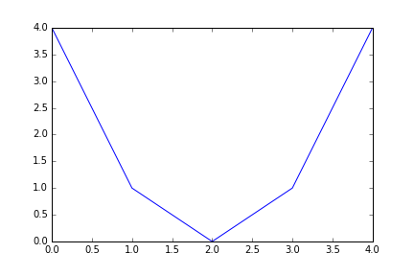
A simple plot My First Example
from matplotlib.pyplot import *
x = [0, 1, 2, 3, 4]
y = [4, 1, 0, 1, 4]
plot(x, y)
show()

Slide 3
A simple plot Save the Image!
from matplotlib.pyplot import *
x = [0, 1, 2, 3, 4]
y = [4, 1, 0, 1, 4]
plot(x, y)
savefig(‘plot_001A.png’)

Slide 4
A simple plot Save the Image!
from matplotlib.pyplot import *
x = [0, 1, 2, 3, 4]
y = [4, 1, 0, 1, 4]
plot(x, y)
savefig(‘plot_001A.png’, dpi=96)

Slide 5
A simple plot Let’s do it the “right” way
import matplotlib.pyplot as plt
x = [0, 1, 2, 3, 4]
y = [4, 1, 0, 1, 4]
plt.plot(x, y)
plt.show()

Slide 6
A simple plot Let’s do it the “right” way
import matplotlib.pyplot as plt
import numpy as np
x = np.arange(5)
y = x ** 2 – 4 * x + 4
plt.plot(x, y)
plt.show()

Slide 7
A simple plot Let’s do it the “right” way
x = np.linspace(0, 10, 1000)
y = x ** 2 – 4 * x + 4
plt.plot(x, y)
plt.show()

Slide 8
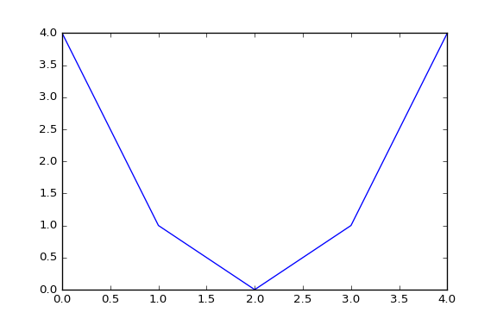
A simple plot Plot and plot again…
plt.plot(x, y)
x = np.arange(5)
y = x ** 2 – 4 * x + 4

Slide 9
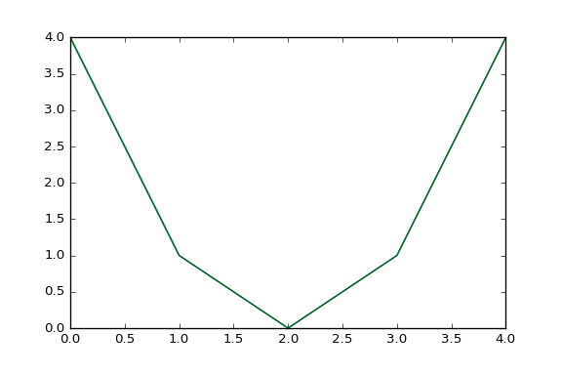
A simple plot Plot and plot again…
plt.plot(x, y)
plt.plot(x, y)
x = np.arange(5)
y = x ** 2 – 4 * x + 4

Slide 10
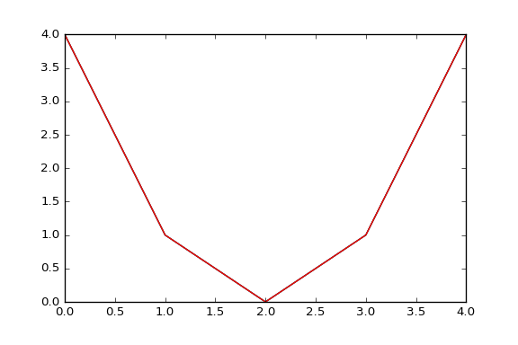
A simple plot Plot and plot again…
plt.plot(x, y)
plt.plot(x, y)
plt.plot(x, y)
x = np.arange(5)
y = x ** 2 – 4 * x + 4

Slide 11
A simple plot Plot with style
def f(t):
return (t - 2) ** 2

Slide 12
A simple plot Plot with style
def f(t):
return (t - 2) ** 2
t1 = np.arange(0.0, 5.0, 0.5)
t2 = np.arange(0.0, 5.0, 0.02)

Slide 13
A simple plot Plot with style
def f(t):
return (t - 2) ** 2
t1 = np.arange(0.0, 5.0, 0.5)
t2 = np.arange(0.0, 5.0, 0.02)
plt.plot(t1, f(t1), 'ro’)
plt.plot(t2, f(t2), 'k')

Slide 14
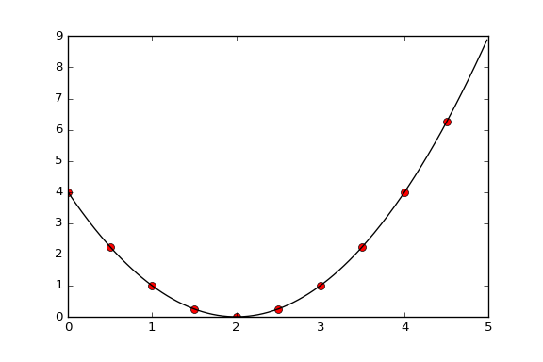
A simple plot Plot with style
def f(t):
return (t - 2) ** 2
t1 = np.arange(0.0, 5.0, 0.5)
t2 = np.arange(0.0, 5.0, 0.02)
plt.plot(t1, f(t1), 'ro', t2, f(t2), 'k')

Slide 15
A simple plot Plot with style
def f(t):
return (t - 2) ** 2
t1 = np.arange(0.0, 5.0, 0.5)
t2 = np.arange(0.0, 5.0, 0.02)
plt.plot(t1, f(t1), 'ro’, t2, f(t2), 'k')

Slide 16
A simple plot Plot with style
def f(t):
return (t - 2) ** 2
t1 = np.arange(0.0, 5.0, 0.5)
t2 = np.arange(0.0, 5.0, 0.02)
plt.plot(t1, f(t1), 'ro', t2, f(t2), 'k')

Slide 17
A simple plot Plot with style
def f(t):
return (t - 2) ** 2
t1 = np.arange(0.0, 5.0, 0.5)
t2 = np.arange(0.0, 5.0, 0.02)
plt.plot(t1, f(t1), 'ro', t2, f(t2), 'k')
plt.xlabel(“t [s]”)

Slide 18
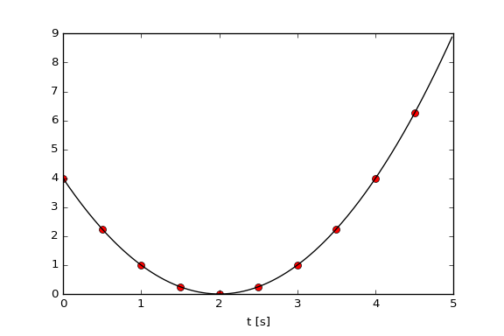
A simple plot Plot with style
def f(t):
return (t - 2) ** 2
t1 = np.arange(0.0, 5.0, 0.5)
t2 = np.arange(0.0, 5.0, 0.02)
plt.plot(t1, f(t1), 'ro', t2, f(t2), 'k')
plt.xlabel(“t [s]”)

Slide 19
A simple plot Plot with style
def f(t):
return (t - 2) ** 2
t1 = np.arange(0.0, 5.0, 0.5)
t2 = np.arange(0.0, 5.0, 0.02)
plt.plot(t1, f(t1), 'ro', t2, f(t2), 'k')
plt.xlabel(“t [s]”)
plt.ylabel(u"f(t) = (t – 2)$^2$")

Slide 20
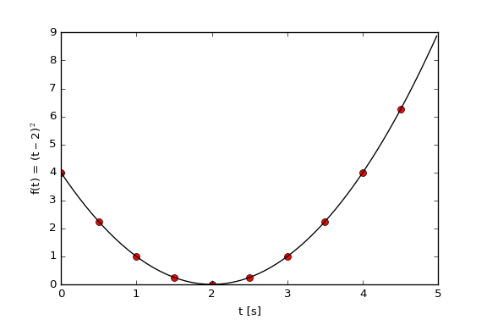
A simple plot Plot with style
def f(t):
return (t - 2) ** 2
t1 = np.arange(0.0, 5.0, 0.5)
t2 = np.arange(0.0, 5.0, 0.02)
plt.plot(t1, f(t1), 'ro', t2, f(t2), 'k')
plt.xlabel(“t [s]”)
plt.ylabel(u"f(t) = (t – 2)$^2$")

Slide 21
A simple plot Plot with style
def f(t):
return (t - 2) ** 2
t1 = np.arange(0.0, 5.0, 0.5)
t2 = np.arange(0.0, 5.0, 0.02)
plt.plot(t1, f(t1), 'ro', t2, f(t2), 'k')
plt.xlabel(“t [s]”, fontsize=24)
plt.ylabel(u"f(t) = (t – 2)$^2$”,
fontsize=24)

Slide 22
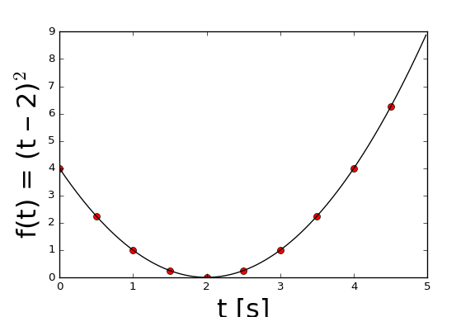
A simple plot Plot with style
def f(t):
return (t - 2) ** 2
t1 = np.arange(0.0, 5.0, 0.5)
t2 = np.arange(0.0, 5.0, 0.02)
plt.plot(t1, f(t1), 'ro', t2, f(t2), 'k')
plt.xlabel(“t [s]”, fontsize=24)
plt.ylabel(u"f(t) = (t – 2)$^2$”,
fontsize=24)

Slide 23
A simple plot Plot with style
import matplotlib as mpl
mpl.rcParams['xtick.labelsize'] = 18
...
plt.plot(t1, f(t1), 'ro', t2, f(t2), 'k')
plt.xlabel(“t [s]”, fontsize=24)
plt.ylabel(u"f(t) = (t – 2)$^2$”,
fontsize=24)

Slide 24
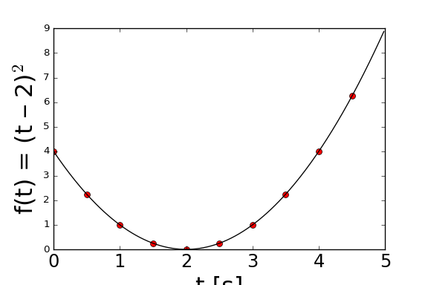
A simple plot Plot with style
import matplotlib as mpl
mpl.rcParams['xtick.labelsize'] = 18
...
plt.plot(t1, f(t1), 'ro', t2, f(t2), 'k')
plt.xlabel(“t [s]”, fontsize=24)
plt.ylabel(u"f(t) = (t – 2)$^2$”,
fontsize=24)

Slide 25
A simple plot Plot with style
import matplotlib as mpl
mpl.rcParams['xtick.labelsize'] = 18
mpl.rcParams[’ytick.labelsize'] = 18
...
plt.plot(t1, f(t1), 'ro', t2, f(t2), 'k')
plt.xlabel(“t [s]”, fontsize=24)
plt.ylabel(u"f(t) = (t – 2)$^2$”,
fontsize=24)

Slide 26
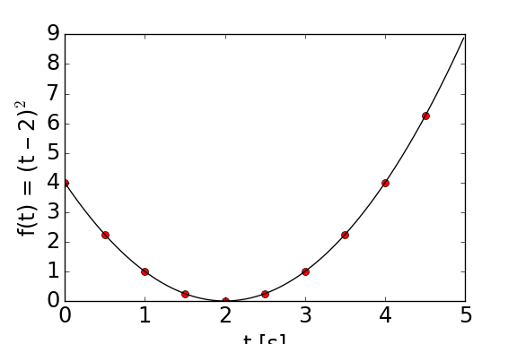
A simple plot Plot with style
import matplotlib as mpl
mpl.rcParams['font.size'] = 18
...
plt.plot(t1, f(t1), 'ro', t2, f(t2), 'k')
plt.xlabel(“t [s]”, fontsize=24)
plt.ylabel(u"f(t) = (t – 2)$^2$”,
fontsize=24)

Slide 27
A simple plot Plot with style
import matplotlib as mpl
mpl.rcParams['font.size'] = 18
print mpl.rcParams

Slide 28
A simple plot Plot with style
...
plt.plot(t1, f(t1), 'o', t2, f(t2), 'k')
...

Slide 29

Questions?

